Slide 1

SPECTRUM SWITCH
De Vera, Kenneth
Lopez, Marienne
Sabellon, Aileen Benz

Slide 2
ART BIBLE

Slide 3








ART STYLE
CHARACTER CHANGES
INTO RANDOM COLORS
CHARACTER ART USES
A SIMPLE CIRCULAR
GEOMETRY SHAPE
PLAYER CAN MOVE TO THE LEFT, TO THE RIGHT, OR JUMP
ART STYLE IS VERY SIMPLE
STYLIZED GEOMETRY SHAPES FOR
OBSTACLES AND PLATFORM

Slide 4

CHARACTER ART
CHARACTER DESIGN IS CREATED USING A CIRCULAR
GEOMETRY SHAPE AND COLORS THAT COMPLIMENTS EACH OTHER
CHARACTER CAN ALSO BE CHANGED INTO A NEUTRAL COLOR (WHITE)
WHICH WILL ALLOW IT TO PASS THROUGH ANY OBSTACLE WITH ANY COLOR

Slide 5







LEVEL OF DETAILS
THIS BUFF CHANGES THE
PLAYER’S COLOR
THIS IS THE SCORE, IT GIVES THE PLAYER POINTS TO USE
IN THE STORE
THIS IS FINISH LINE OF THE GAME
ENTERING THIS WILL MOVE THE PLAER TO THE NEXT LEVEL
PLAYER CAN ONLY STAND ON PLATFORMS
AND PASS THROUGH OBSTACLES
IF THEY HAVE THE SAME COLOR AS THE PLAYER’S.
DOING OTHERWISE WILL RESULT TO A GAME OVER

Slide 6



CAMERA
SCORE IS VISIBLE TO THE PLAYER FOR EASY TRACK
PAUSE BUTTON IS VISIBLE IN THE SCREEN
PLAYER STARTS AT THE LEFT AND
PROGRESS TO THE RIGHT
SIDE SCROLLER POINT OF VIEW

Slide 7








COLOR PALETTE
#005b7f
#00ff00
#ed145b
#fc9d03
#4f385c
#5e5e5e
USES WARM AND COOL COLORS
THAT COMPLIMENTS EACH OTHER WHICH
MAY WORK FOR CASUAL AUDIENCE
AND MAKE THE GAME FEEL PUZZLE PACKED

Slide 8
ATMOSPHERE OR ENVIRONMENT
ALL OF THE ELEMENTS ARE AT THE BOTTOM
HALF, WHICH GIVES PLAYER FOCUS ON THE
PLATFORMS AND OBSTACLES
COLOR SCHEME OF THE PLAYER, PLATFORM
AND OBSTACLES ARE BRIGHTER THAN THE
BACKGROUND TO MAKE THEM STAND OUT

Slide 9

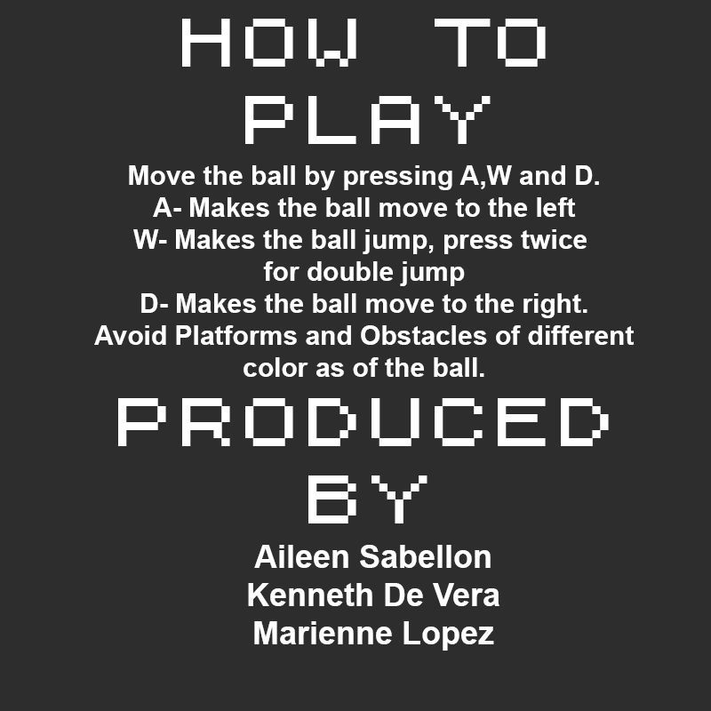
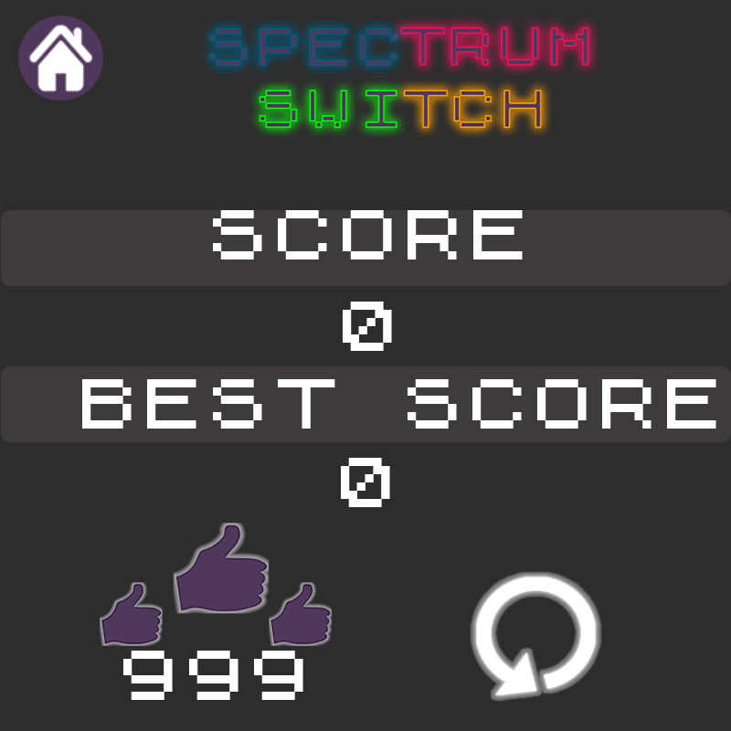
USER INTERFACE
MAIN MENU SCENE
HOW TO PLAY SCENE
GAME OVER SCENE

Slide 10


USER INTERFACE
PAUSE SCENE
SETTINGS SCENE
GAME SCENE

Slide 11







TECHNICAL GUIDELINES
GAME STRUCTURE
NAMING CONVENTION
(WHAT FOR)_(TYPE)_(NAME)
FINALLY THE OBSTACLES AND OTHER
ELEMENTS OF THE GAME
THEN THE PLATFORMS
DESIGN
SPRITE
THEN THE PLATFORM BASE
BACKGROUND AS BASE

Slide 12




REFERENCES/MOOD BOARDS

Slide 13



GAME CREATORS
AILEEN SABELLON
KENNETH DE VERA
MARIENNE LOPEZ

